Slide 1
Decision support system
A decision support system (DSS) is a computer-based information system that supports business or organizational decision-making activities.
It provides analytical tools and databases to help users make informed decisions.
DSS typically integrates data from various sources, processes it, and presents it in a format that is easily understandable and actionable.
Key components of a decision support system include:
Database Management System (DBMS): Stores and manages data relevant to the decision-making process.
Model Base Management System (MBMS): Contains mathematical and statistical models that aid in analyzing data and simulating different scenarios.
User Interface: Provides a platform for users to interact with the system, input their queries, and receive outputs.
Decision-makers: Human users who utilize the DSS to make informed decisions.

Slide 2
DSS types of decisions – Structured decisions
Structured decisions are routine and repetitive decisions that have a clear procedure for handling them.
These decisions can be automated and typically involve straightforward problems with known solutions.
The steps to solve these problems are well-defined, and the data required to make the decisions are readily available.
Examples:
Inventory control
Payroll processing
Order processing
Scheduling

Slide 3
DSS types of decisions – Structured decisions
Structured decisions are routine and repetitive decisions that have a clear procedure for handling them.
These decisions can be automated and typically involve straightforward problems with known solutions.
The steps to solve these problems are well-defined, and the data required to make the decisions are readily available.
Examples:
Inventory control
Payroll processing
Order processing
Scheduling

Slide 4
DSS types of decisions – Semistructured decisions
Semi-structured decisions have elements of both structured and unstructured decisions.
While some aspects of the decision-making process are well-defined, others require human judgment and expertise.
DSS can assist by providing relevant information, data analysis, and models to support decision-makers, but human intervention is still necessary to evaluate and interpret the results.
Examples:
Budgeting
Sales forecasting
Financial analysis
Marketing strategy

Slide 5
Category - DSS
Decision support systems can be categorized into different types based on their functionality:
Data-driven DSS: These systems primarily analyze large datasets to identify patterns and trends, helping users make decisions based on historical data.
Model-driven DSS: These systems utilize mathematical and statistical models to simulate various scenarios and predict outcomes based on user input.
Knowledge-driven DSS: These systems rely on expert knowledge and rules to provide recommendations and insights to users.

Slide 6
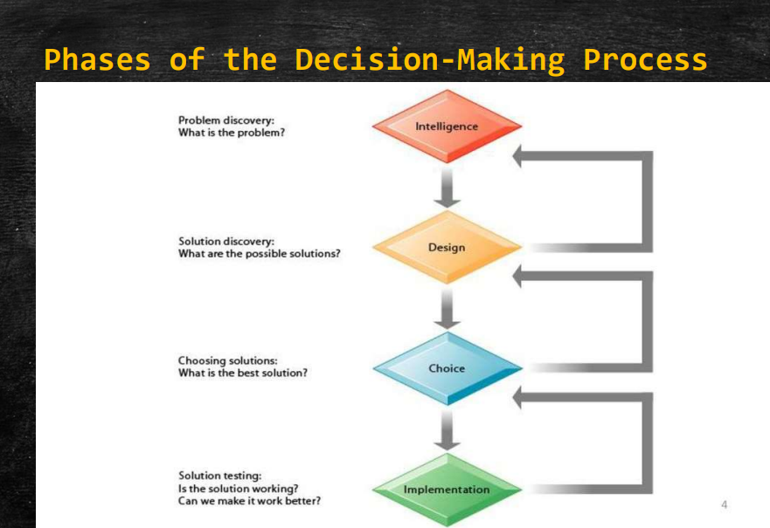

Slide 7
Decision making process
The decision-making process typically involves several phases, each of which contributes to reaching a conclusion or making a choice. Here are the common phases:
Identifying the Problem or Opportunity: This phase involves recognizing that a decision needs to be made. It may stem from a problem that needs to be solved or an opportunity that needs to be pursued.
Gathering Information: In this phase, relevant data and information are collected to understand the situation better. This might involve research, data analysis, or consulting with experts.
Generating Alternatives: Once information is gathered, various options or alternatives are brainstormed. This step involves creativity and critical thinking to come up with potential solutions or courses of action.

Slide 8
Decision making process
Evaluating Alternatives: Each alternative is carefully evaluated based on criteria such as feasibility, effectiveness, risks, and benefits. This step may involve weighing pros and cons, conducting cost-benefit analyses, or using decision-making models.
Making the Decision: After evaluating the alternatives, a decision is made to choose the best course of action. This decision may be made by an individual or a group, depending on the context.
Implementing the Decision: Once the decision is made, it needs to be put into action. This phase involves planning and executing the chosen course of action.
Evaluating the Outcome: After implementation, the results of the decision are assessed to determine whether the desired outcomes were achieved. This step provides feedback that can be used to adjust future decisions or strategies.

Slide 9
Advantages - DSS
Decision Support Systems (DSS) offer numerous advantages:
Enhanced Decision-Making: DSS provides decision-makers with timely and relevant information, enabling them to make better-informed and more effective decisions.
Improved Efficiency: By automating data collection, analysis, and presentation, DSS streamlines the decision-making process, saving time and resources.
Integration of Data: DSS can integrate data from various sources and formats, providing a comprehensive view of the situation and facilitating more holistic decision-making.
Scenario Analysis: DSS allows decision-makers to simulate different scenarios and assess the potential outcomes of various decisions, helping them choose the most favorable course of action.
Support for Complex Decisions: In situations where decisions involve numerous variables and factors, DSS can handle complexity and uncertainty, assisting decision-makers in navigating intricate decision landscapes.
Customization: DSS can be tailored to the specific needs and preferences of individual users or decision-making contexts, ensuring that the information and analyses provided are relevant and meaningful.
Real-Time Insights: Some DSS are capable of providing real-time data and analysis, allowing decision-makers to respond promptly to changing conditions and emerging opportunities or threats.
Collaboration: DSS can facilitate collaboration and communication among decision-makers and stakeholders, enabling them to share insights, discuss options, and collectively arrive at decisions.
Risk Management: DSS can help identify and assess risks associated with different decision options, allowing decision-makers to mitigate potential negative consequences.
Strategic Advantage: Organizations that effectively utilize DSS can gain a strategic advantage by making more informed and timely decisions, leading to improved performance and competitiveness.

Slide 10
Disadvantages - DSS
While Decision Support Systems (DSS) offer many advantages, they also have some disadvantages:
High Cost: Implementing a DSS can be expensive, involving costs for software, hardware, and ongoing maintenance. Small organizations might find it difficult to justify these expenses.
Complexity: DSS can be complex to design, implement, and use. Users may require extensive training to effectively utilize the system, which can be time-consuming and costly.
Dependency on Technology: Over-reliance on DSS can lead to a reduction in human intuition and judgment, potentially undermining decision-making in situations where human experience and expertise are crucial.
Data Quality Issues: The effectiveness of a DSS depends on the quality and accuracy of the data it uses. Poor data quality can lead to incorrect analyses and misguided decisions.
Integration Challenges: Integrating DSS with existing systems and databases can be challenging, requiring significant time and effort to ensure seamless operation.

Slide 11
Disadvantages - DSS
Security Concerns: Storing and processing large amounts of sensitive data in a DSS can pose security risks. Unauthorized access or data breaches can have serious consequences.
Resistance to Change: Employees and decision-makers might resist adopting a DSS due to comfort with traditional methods or fear of new technology, hindering effective implementation.
Maintenance and Updates: Regular maintenance and updates are required to keep the DSS functioning optimally and to incorporate new data and changing business requirements. This can be resource-intensive.
Limited Scope: Some DSS are designed for specific types of decisions or industries, limiting their applicability and usefulness in different contexts.
Potential for Misuse: Inappropriate or incorrect use of a DSS can lead to poor decisions. Users need to understand the system's limitations and the context of the data and analyses it provides.
Dependence on Accurate Models: DSS often rely on models to simulate scenarios and predict outcomes. If these models are flawed or based on incorrect assumptions, the resulting decisions may be suboptimal.
Time-Consuming Implementation: Developing and deploying a DSS can be time-consuming, delaying the potential benefits and requiring significant initial effort.

Slide 12
Components - DSS
1. Users
End-Users:
Decision-makers who interact with the DSS to obtain information, run analyses, and make decisions. They may include managers, executives, analysts, and other stakeholders.
Technical Staff:
IT professionals and system administrators responsible for maintaining, updating, and troubleshooting the DSS. They ensure the system runs smoothly and securely.
2. Database Management System (DBMS)
Database:
A structured collection of data relevant to the organization. It can include historical data, real-time data, and external data sources.
DBMS Software:
Tools and software used to create, manage, and query the database. The DBMS provides functionalities for data storage, retrieval, and management, ensuring data integrity and security.

Slide 13
Components - DSS
3. Model-Driven Management System (MDMS)
Models:
Mathematical and analytical models that process data to produce useful information for decision-making. These can include statistical models, financial models, optimization models, and simulation models.
Model Management Software:
Software that facilitates the creation, storage, and execution of models. It allows users to define and manipulate models, run simulations, and perform scenario analysis.
4. User Interface
Interface Tools:
The component that allows users to interact with the DSS. This includes dashboards, reporting tools, query interfaces, and visualization tools that present data and model outputs in an understandable format.
Usability:
Ensuring the user interface is intuitive and easy to use, enabling users to effectively leverage the system without requiring extensive technical knowledge.

Slide 14
Components - DSS
5. Knowledge Base
Expert Systems:
A component that integrates expert knowledge and business rules to enhance decision-making. It may include rule-based systems, artificial intelligence, and machine learning algorithms.
Knowledge Management:
Tools and processes for capturing, storing, and retrieving organizational knowledge, best practices, and historical decision data.
6. Communication System
Networking:
Infrastructure that enables data exchange and communication between different components of the DSS, and with external data sources and users.
Collaboration Tools:
Tools that facilitate communication and collaboration among users, such as messaging systems, shared workspaces, and collaboration platforms.

Slide 15
Components - DSS
7. Data Sources
Internal Data:
Data generated within the organization, such as sales records, financial reports, and operational data.
External Data:
Data obtained from external sources, including market trends, economic indicators, competitor information, and social media.
8. Analytical Tools
Data Mining:
Techniques for discovering patterns and relationships in large datasets.
OLAP (Online Analytical Processing):
Tools that allow users to interactively analyze multidimensional data from multiple perspectives.
Business Intelligence:
Technologies and practices for the collection, integration, analysis, and presentation of business information.

Slide 16
Types of Decision Support System
1. Data-Driven DSS
Characteristics:
Focuses on the retrieval and manipulation of large volumes of structured data.
Utilizes databases, data warehouses, and online analytical processing (OLAP).
Examples:
Business intelligence systems
Reporting tools
Use Cases:
Sales and financial analysis
Inventory management
Customer relationship management

Slide 17
Types of Decision Support System
2. Model-Driven DSS
Characteristics:
Relies on mathematical models and algorithms to analyze data and support decision-making.
Models can include optimization, simulation, and statistical models.
Examples:
Financial modeling systems
Risk analysis tools
Scheduling systems
Use Cases:
Budgeting and forecasting
Production planning
Logistics and supply chain management

Slide 18
Types of Decision Support System
3. Knowledge-Driven DSS
Characteristics:
Provides specialized problem-solving expertise stored as facts, rules, procedures, or in similar structures.
Often incorporates artificial intelligence and expert systems.
Examples:
Diagnostic systems
Advisory systems
Use Cases:
Medical diagnosis
Equipment repair and maintenance
Investment advice

Slide 19
Types of Decision Support System
4. Document-Driven DSS
Characteristics:
Manages, retrieves, and manipulates unstructured or semi-structured documents.
Uses text search and retrieval tools.
Examples:
Document management systems
Legal research systems
Use Cases:
Legal case analysis
Policy documentation
Contract management

Slide 20
Types of Decision Support System
5. Communication-Driven DSS
Characteristics:
Facilitates collaboration and communication among team members.
Often integrates groupware and collaboration tools.
Examples:
Group decision support systems (GDSS)
Video conferencing systems
Use Cases:
Team meetings and brainstorming
Project management
Collaborative writing and editing

Slide 21
Where to use DSS?
Business Management: DSS aids managers in making strategic, tactical, and operational decisions by providing relevant information and analysis. It assists in areas like financial planning, resource allocation, and performance evaluation.
Healthcare: DSS helps healthcare professionals in diagnosing diseases, planning treatments, and managing patient care. It can analyze medical records, lab results, and patient histories to support clinical decision-making.
Finance and Investment: DSS assists investors, traders, and financial analysts in making investment decisions. It can analyze market trends, financial data, and risk factors to recommend investment strategies and portfolio management.
Supply Chain Management: DSS supports decision-making in supply chain optimization, inventory management, and logistics. It helps in forecasting demand, optimizing distribution routes, and managing inventory levels to improve efficiency and reduce costs.

Slide 22
Where to use DSS?
Marketing and Sales: DSS aids marketers and sales teams in identifying target markets, analyzing customer behavior, and designing marketing campaigns. It can analyze sales data, customer demographics, and market trends to optimize marketing strategies.
Environmental Management: DSS assists environmental scientists and policymakers in analyzing environmental data, modeling ecological systems, and making decisions related to conservation, pollution control, and sustainable development.
Education: DSS helps educators and administrators in planning curriculum, evaluating student performance, and allocating resources. It can analyze student data, learning outcomes, and teaching effectiveness to improve educational outcomes.
Transportation and Urban Planning: DSS assists transportation planners and urban developers in designing transportation systems, optimizing traffic flow, and planning urban infrastructure. It can analyze traffic patterns, demographic data, and environmental factors to support urban planning decisions.
Agriculture: DSS aids farmers and agricultural experts in optimizing crop production, managing resources, and mitigating risks. It can analyze weather data, soil conditions, and crop yields to recommend planting schedules, irrigation strategies, and pest control measures.

Slide 23
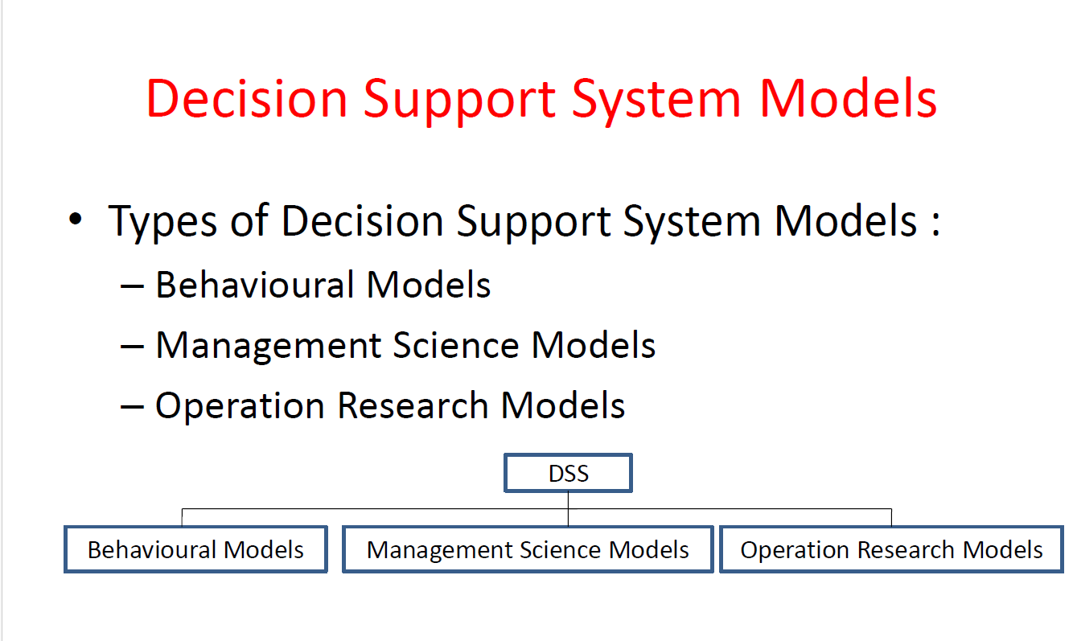

Slide 24
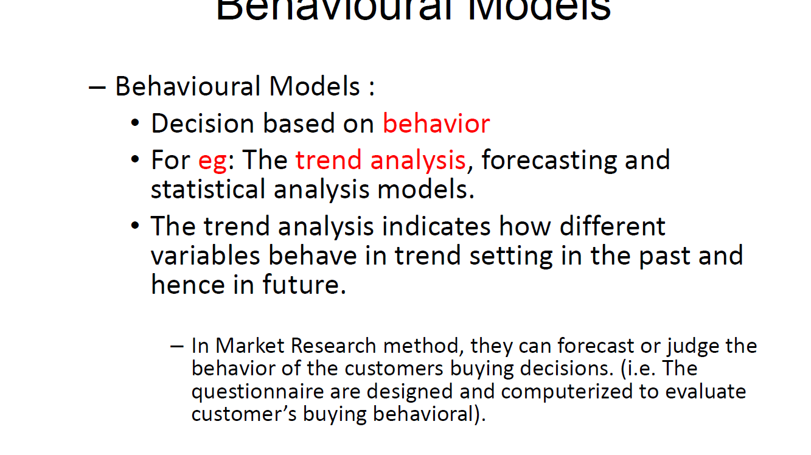

Slide 25
Behavioral Model
Behavioral models in Decision Support Systems (DSS) focus on understanding and improving decision-making processes by incorporating human behavior, cognitive processes, and social dynamics.
These models aim to enhance the effectiveness of decisions by taking into account how individuals and groups actually make decisions, rather than relying solely on mathematical or statistical optimization.
Behavioral model DSS are designed to support decision-making by:
Recognizing Cognitive Biases: Identifying and mitigating biases and heuristics that can affect judgment and decision-making.
Facilitating Group Dynamics: Supporting collaborative decision-making processes by addressing group interactions, communication patterns, and conflict resolution.
Enhancing Human Intuition and Judgment: Leveraging the strengths of human intuition and expertise in complex, ambiguous situations.
Providing Scenario Analysis: Allowing decision-makers to explore and compare different scenarios and their potential outcomes.

Slide 26
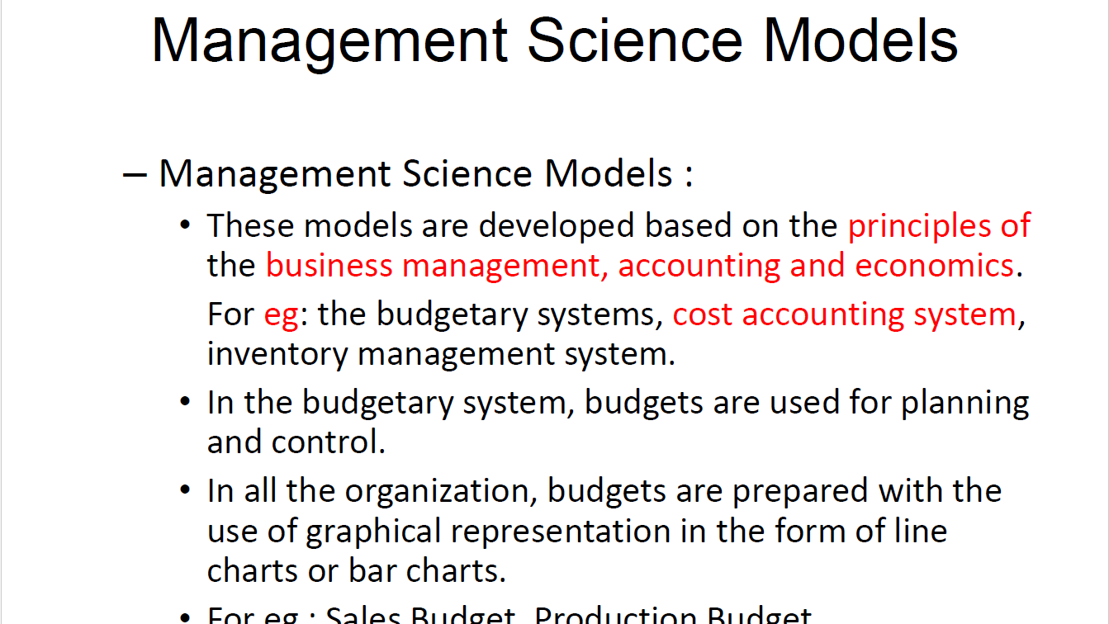

Slide 27
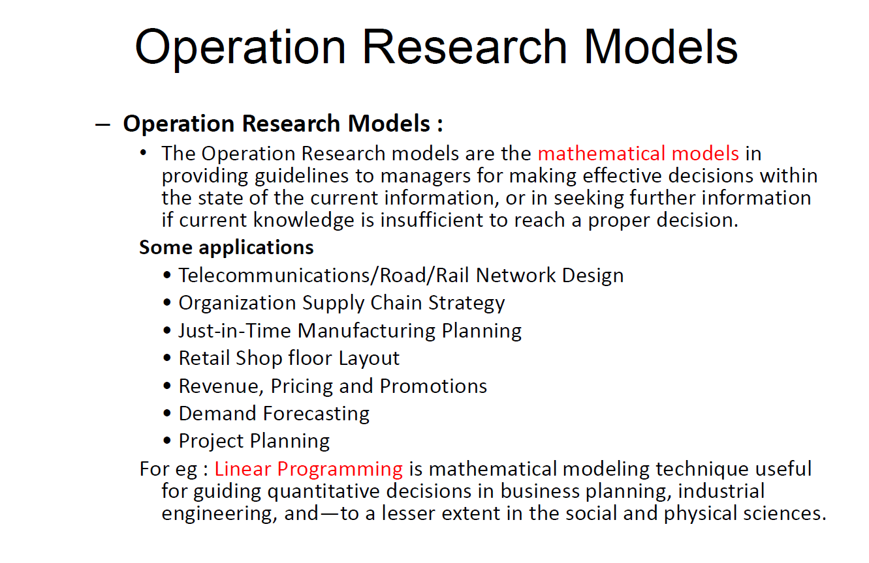

Slide 28
Group decision support system (GDSS)
A Group Decision Support System (GDSS) is designed to facilitate decision-making processes for groups.
These systems support collaborative work by providing tools and techniques that enhance communication, decision-making, and problem-solving among team members.
GDSS aim to improve the quality and efficiency of group decisions by leveraging technology to manage group dynamics, collect and analyze data, and generate solutions.
GDSS are designed to:
Enhance Communication: Provide platforms for real-time and asynchronous communication among group members.
Improve Collaboration: Enable sharing of information, ideas, and documents to foster collaborative decision-making.
Support Structured Decision-Making: Use methods like brainstorming, voting, and ranking to structure the decision-making process.
Facilitate Consensus Building: Help groups reach consensus by providing tools for discussion, negotiation, and conflict resolution.

Slide 29
Group decision support system (GDSS)
Components of a GDSS
Communication Tools: Facilitate interaction among group members through chat, video conferencing, and discussion forums.
Collaboration Tools: Enable sharing and collaborative editing of documents, spreadsheets, and presentations.
Decision-Making Tools: Provide methods for generating, evaluating, and selecting alternatives, such as brainstorming tools, voting systems, and multi-criteria decision analysis.
Data Management Tools: Collect, store, and analyze data relevant to the decision-making process.
Reporting Tools: Generate reports and visualizations to summarize findings and support decision-making.

Slide 30
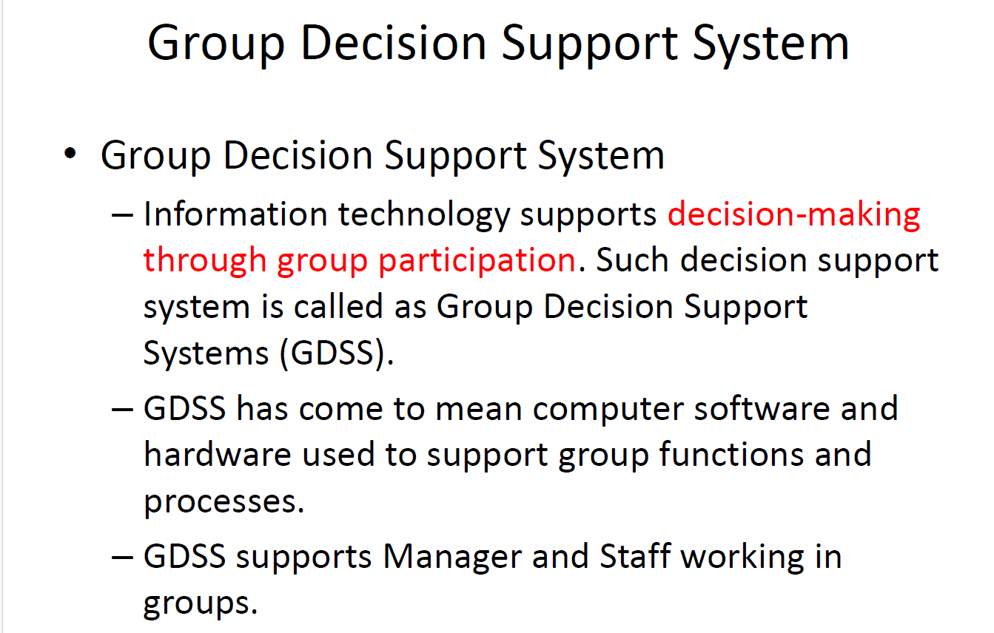

Slide 31
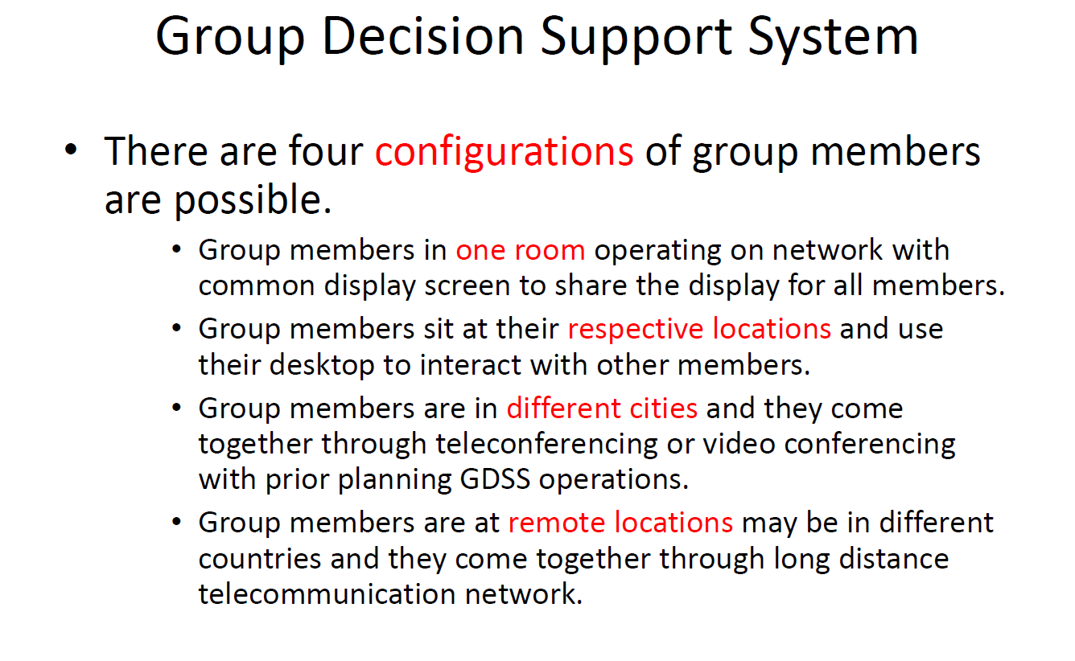

Slide 32
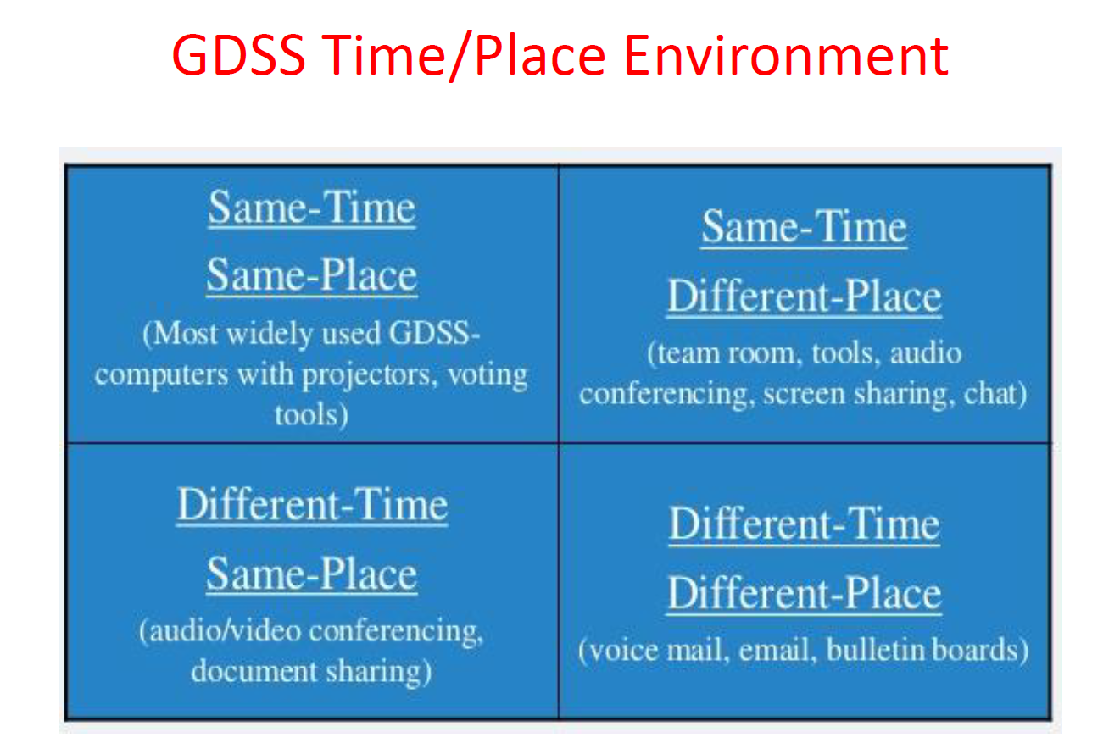

Slide 33
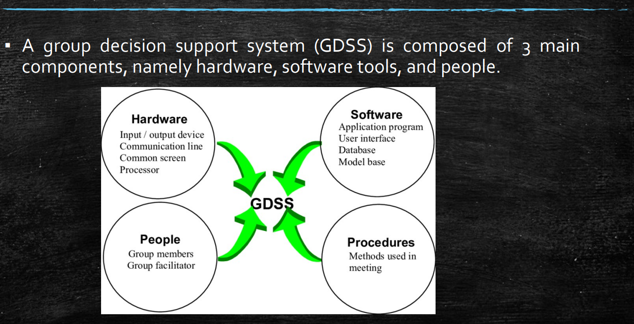

Slide 34
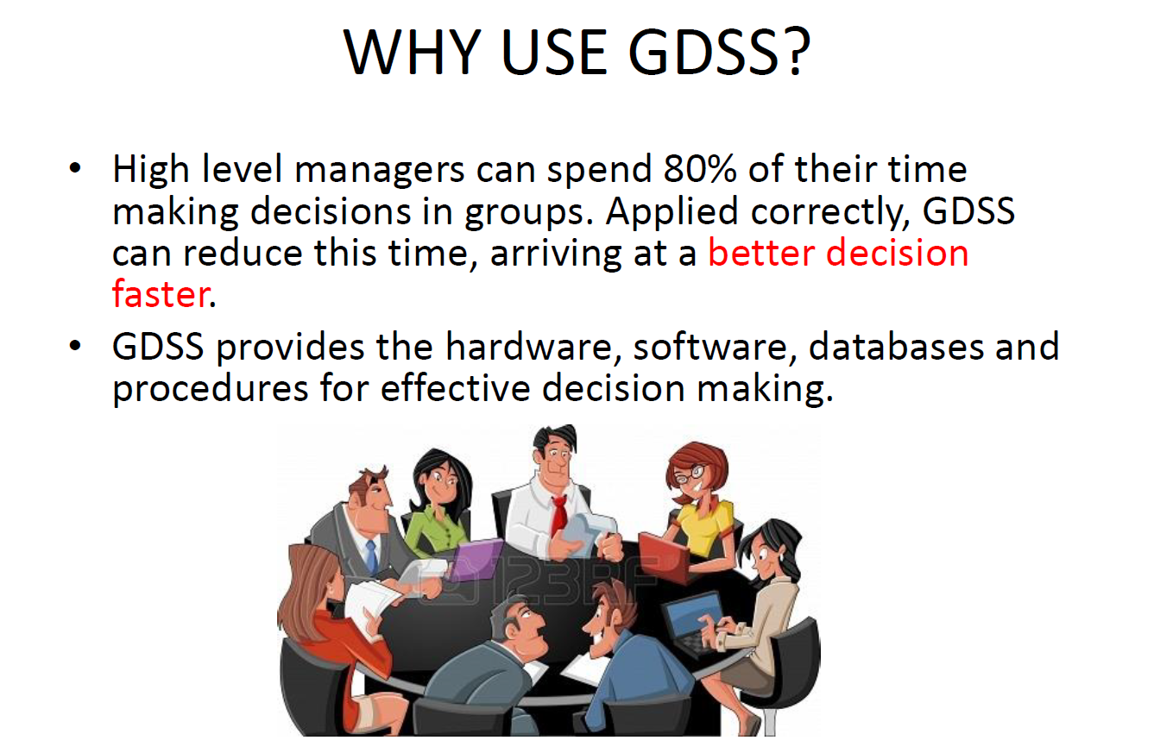

Slide 35
Advantages of GDSS
Enhanced Communication and Collaboration:
GDSS provide platforms for real-time and asynchronous communication, ensuring that all team members, regardless of their location, can participate in discussions and decision-making processes.
Structured Decision-Making:
GDSS use structured methods such as brainstorming, voting, and ranking to organize and streamline decision-making, helping groups stay focused and organized.
Improved Decision Quality:
By leveraging diverse perspectives and expertise, GDSS help groups generate more comprehensive and well-rounded decisions.
Efficient Consensus Building:
GDSS facilitate consensus-building by providing tools for discussion, negotiation, and conflict resolution, ensuring that all members can contribute and agree on the final decision.
Data-Driven Decisions:
GDSS integrate data management tools that allow groups to collect, store, and analyze relevant data, leading to more informed and evidence-based decisions.

Slide 36
Disadvantages of GDSS
Technical Complexity:
Implementing and maintaining GDSS can be technically complex and require significant IT infrastructure and support. Integration with existing systems and ensuring compatibility across different platforms can be challenging.
Costs:
Setting up and maintaining GDSS can be costly, involving expenses for software, hardware, training, and ongoing support. Small organizations or those with limited budgets may find it prohibitive.
User Training and Adoption:
Users may require training to effectively use GDSS tools and understand their functionalities. Resistance to change or reluctance to adopt new technologies can hinder successful implementation.
Security Concerns:
GDSS involve sharing sensitive information and data among group members. Ensuring data security, confidentiality, and protection against cyber threats becomes crucial but challenging.
Group Dynamics and Decision Quality:
The effectiveness of GDSS heavily depends on group dynamics and how well team members collaborate. Issues such as dominance of certain members, groupthink, or lack of participation can affect decision quality
Potential for Information Overload:
GDSS can generate large volumes of data, discussions, and proposals. Managing and processing this information efficiently without overwhelming participants can be daunting.
Dependency on Technology:
Technical failures, internet connectivity issues, or system downtime can disrupt GDSS sessions and impact decision-making processes, especially in real-time scenarios.
Time Constraints:
GDSS sessions may require more time than traditional decision-making methods due to discussions, consensus-building efforts, and the need to accommodate diverse viewpoints.

Slide 37
Enterprise decision support system = EDSS
An Enterprise Decision Support System (EDSS) is a sophisticated type of decision support system designed to support decision-making at the strategic, tactical, and operational levels within an organization.
An Enterprise Decision Support System (EDSS) is a powerful software system that helps organizations make better decisions.
It does this by collecting, analyzing, and presenting information from various parts of the organization.
Think of it as a smart tool that managers and executives use to understand what’s happening in their business and to make choices that will lead to success.

Slide 38
Components - EDSS
Data Integration:
An EDSS pulls together data from different places within the company, like sales records, customer information, and financial reports. It gathers all this information into one place.
Analysis Tools:
It uses special tools to analyze the data. These tools can spot patterns, trends, and relationships in the data that humans might miss. For example, it can tell if sales are higher in certain stores during specific times of the year.
Visualization:
An EDSS shows the analyzed data in easy-to-read charts, graphs, and reports. This helps managers and executives quickly understand what the data means.
Scenario Planning:
It can simulate different scenarios. This means it can predict what might happen if the company changes its strategy. For instance, it can predict how profits might change if prices are lowered or if new products are introduced.
Collaboration Tools:
It includes tools that allow team members to work together on decisions. They can share information, discuss ideas, and come to agreements more easily.

Slide 39
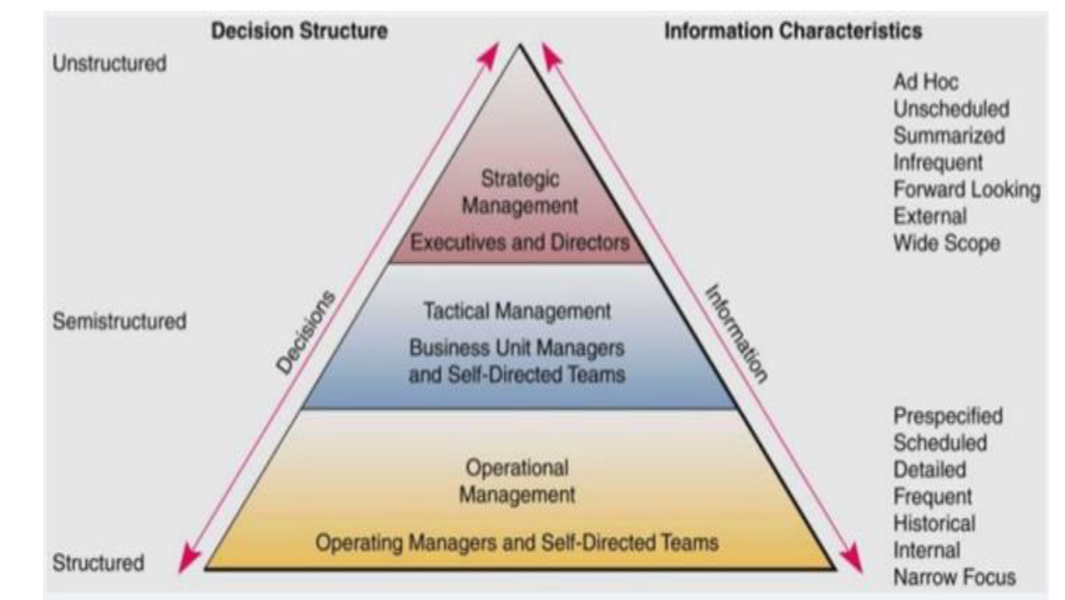

Slide 40
Executive decision support system
An Executive Decision Support System (EDSS) is a specialized type of Decision Support System (DSS) designed to assist top-level executives and senior managers in making strategic decisions for their organization.
It provides powerful tools and insights tailored to meet the specific needs of executives, focusing on high-level strategic planning, resource allocation, and policy formulation.
An Executive Decision Support System (EDSS) is a computer-based system that helps top executives make strategic decisions.
It collects and analyzes data from various sources within and outside the organization, providing valuable insights and recommendations.
EDSS is designed to handle complex decision-making processes and support executives in shaping the future direction of the organization.

Slide 41
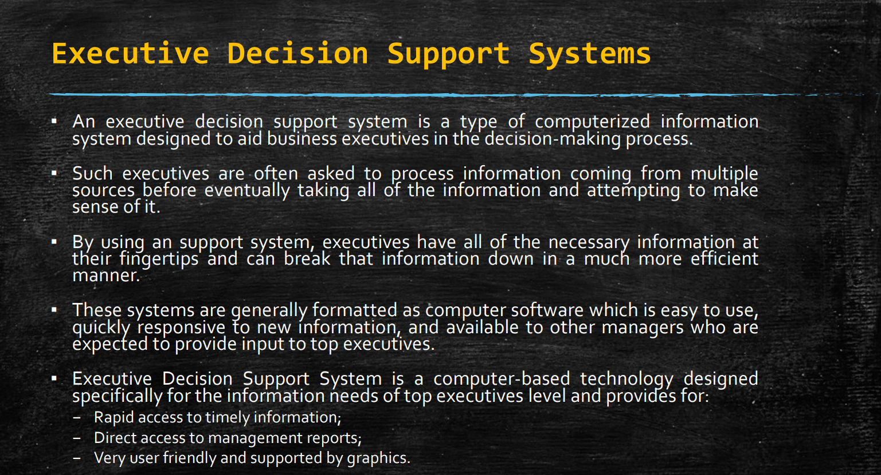

Slide 42
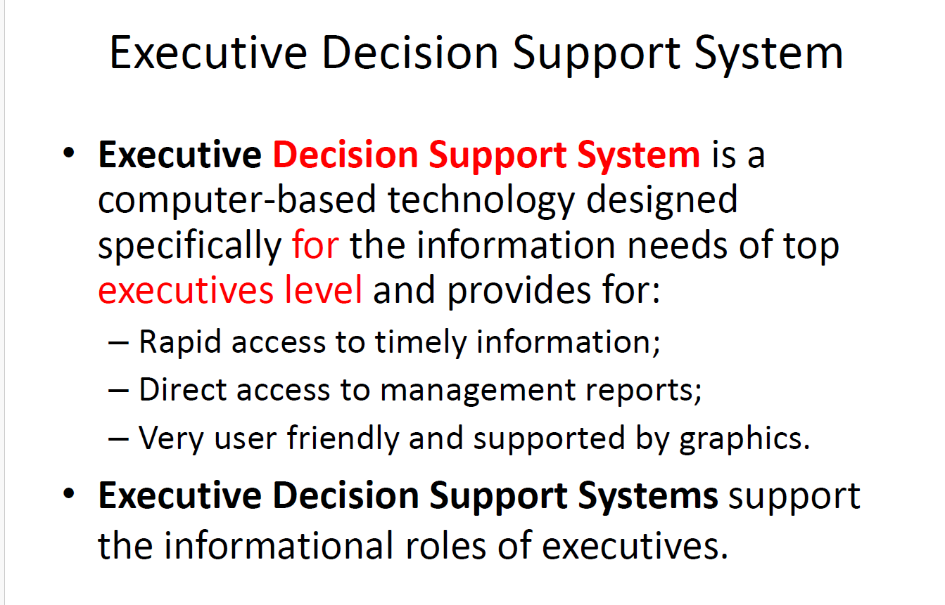

Slide 43
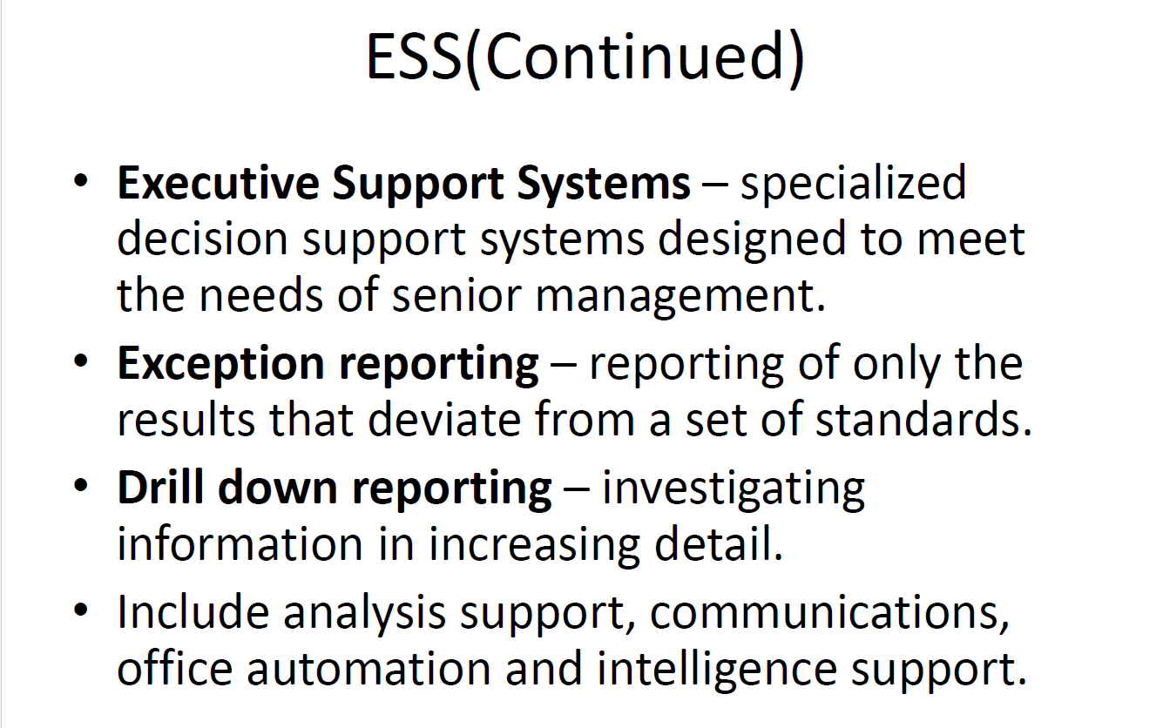

Slide 44
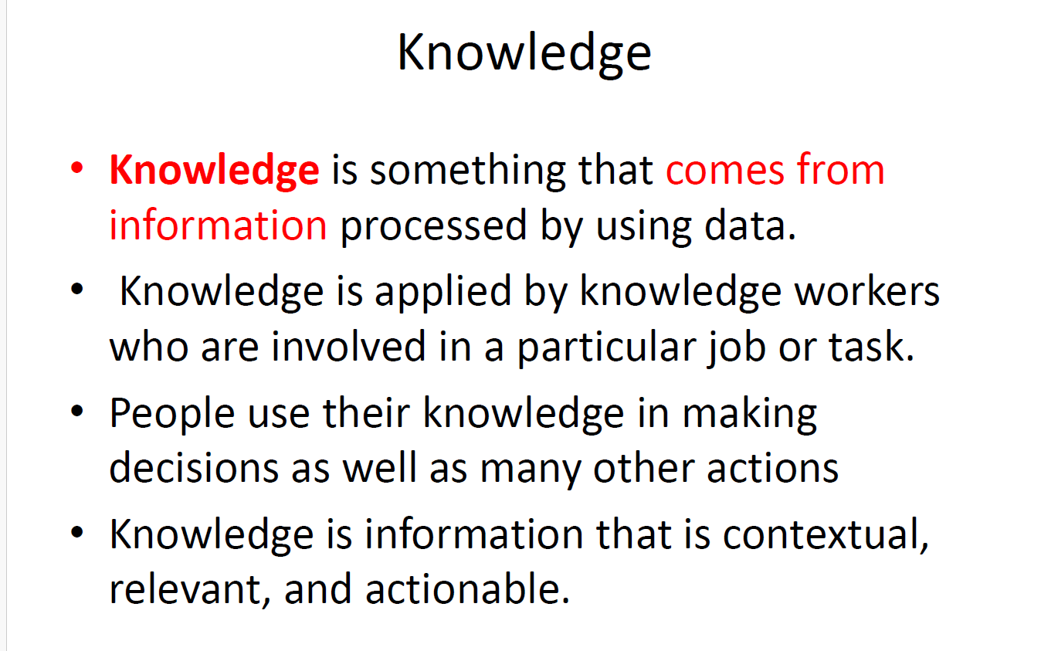

Slide 45
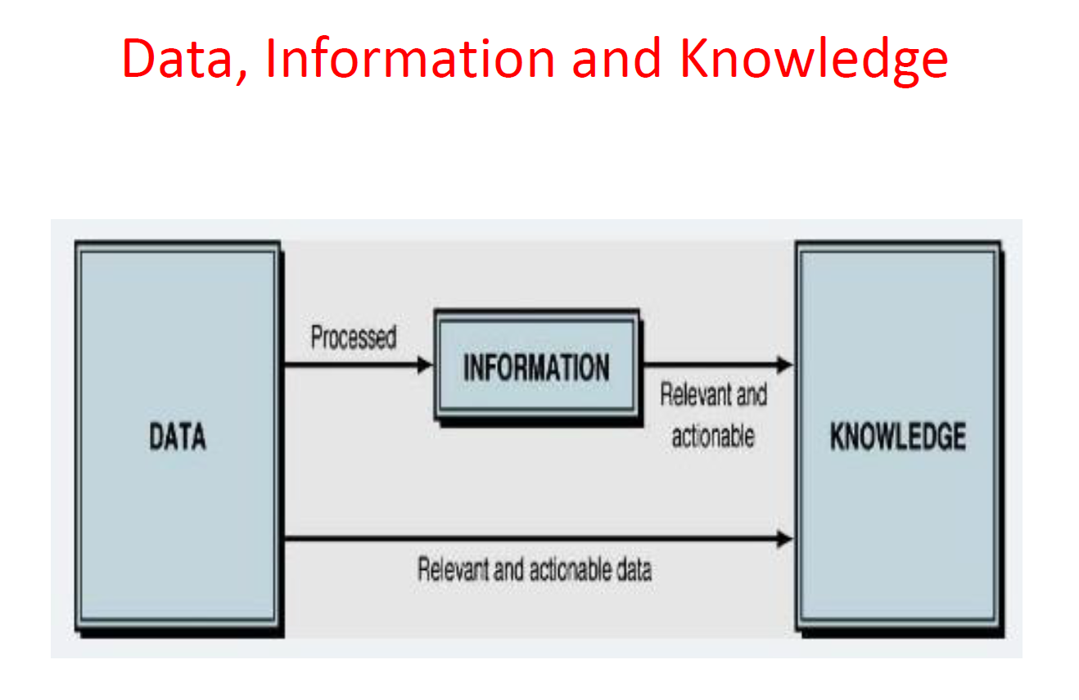

Slide 46
Data , information , knowledge, wisdom
1. Data
Definition: Data refers to raw facts and figures that have no context or meaning on their own.
Characteristics: Data is typically structured and can be in the form of numbers, words, symbols, or images.
Example:
A list of numbers: 100, 75, 120, 90
Names of cities: New York, Tokyo, London
Symbols: %, $
2. Information
Definition: Information is processed data that provides context, relevance, and meaning.
Characteristics: Information answers the questions of who, what, where, and when.
Example:
Sales report for the month of January showing total revenue: $500,000
Weather forecast indicating temperature and precipitation for the week
Employee database listing names, roles, and contact information

Slide 47
Data , information , knowledge, wisdom
3. Definition: Knowledge is derived from information through understanding, experience, and insight.
Characteristics: Knowledge involves the application of information to answer how and why questions.
Example:
Understanding customer preferences based on analyzing sales data and market trends
Knowing how to troubleshoot technical issues in a software system based on previous experience
Expertise in project management gained through years of managing successful projects
4. Wisdom
Definition: Wisdom represents the highest level of understanding and judgment, integrating knowledge and experience to make sound decisions.
Characteristics: Wisdom involves applying principles, values, and ethics to make decisions that consider long-term consequences.
Example:
Deciding to invest in a new technology based on a deep understanding of market trends, customer needs, and strategic goals
Making ethical decisions that prioritize the well-being of employees and stakeholders over short-term gains
Innovating new business strategies that anticipate future market trends and disruptions

Slide 48
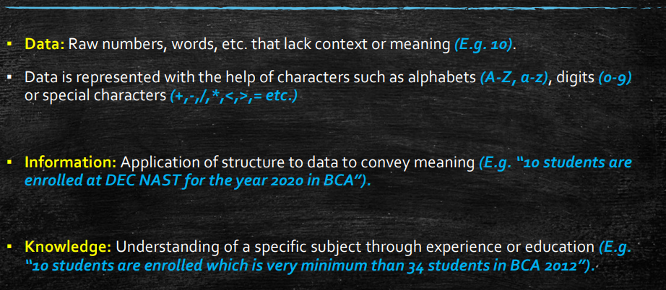

Slide 49
Knowledge – in depth
Knowledge refers to the information, understanding, and skills that individuals acquire through experience, education, and training.
It encompasses facts, concepts, theories, and practical abilities that enable individuals to perform tasks, solve problems, and make informed decisions.
Example : Technical Knowledge
Context: A software developer writing code.
Explanation: Technical knowledge involves understanding programming languages, software development methodologies, algorithms, and debugging techniques.
Relevant Example: A software developer uses their knowledge of the Python programming language to write a script that automates data collection from various online sources. They apply their understanding of web scraping libraries, such as BeautifulSoup, and error-handling techniques to ensure the script runs smoothly and efficiently.
Example: Medical Knowledge
Context: A doctor diagnosing a patient.
Explanation: Medical knowledge includes understanding human anatomy, diseases, symptoms, diagnostic methods, and treatment options.
Relevant Example: A doctor uses their knowledge of the symptoms and progression of diseases like diabetes to diagnose a patient presenting with excessive thirst, frequent urination, and fatigue. Based on this knowledge, the doctor orders appropriate tests, interprets the results, and prescribes a treatment plan.

Slide 50
Knowledge Management
Knowledge management (KM) is the process of capturing, distributing, and effectively using knowledge within an organization.
It involves a combination of strategies, tools, and practices aimed at identifying, creating, representing, and distributing knowledge to ensure that it is accessible and useful to those who need it.
The goal of knowledge management is to improve organizational efficiency, innovation, and decision-making.

Slide 51
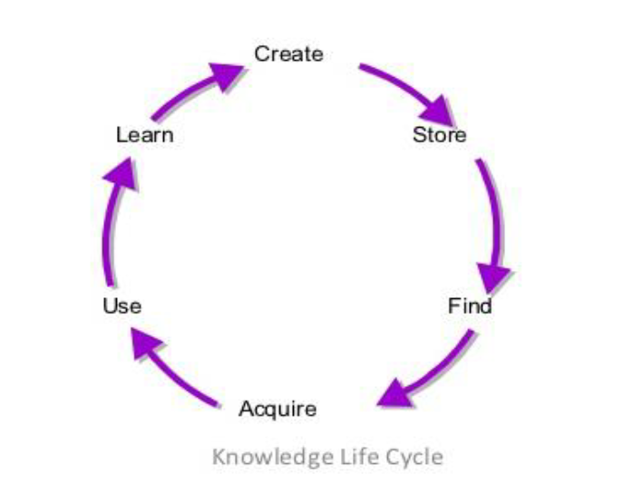
Knowledge managment
Create
Description: This phase involves generating new knowledge through various activities such as research, development, collaboration, and innovation.
Example: A team of engineers in a tech company brainstorms and develops a new algorithm to improve the performance of their software product.
Store
Description: Storing knowledge in a way that it can be easily accessed and retrieved when needed. This often involves using databases, document management systems, and other storage solutions.
Example: The tech company stores the new algorithm, along with documentation and implementation details, in their internal knowledge repository.
Find
Description: This phase involves locating and retrieving stored knowledge when it is needed. Effective indexing and search functionalities are crucial.
Example: A different team within the same company needs to enhance another software product and searches the knowledge repository for relevant algorithms, finding the one previously developed.

Slide 52
Knowledge managment
Acquire
Description: Acquiring external knowledge that can complement or enhance the organization’s existing knowledge base. This may involve obtaining information from external sources such as industry reports, academic research, or consultants.
Example: The tech company acquires a research paper from an academic journal that discusses advanced optimization techniques, which can be applied to their new algorithm.
Use
Description: Applying the retrieved and acquired knowledge to perform tasks, solve problems, and make decisions. This is where knowledge translates into action and value.
Example: The development team uses the stored algorithm and the insights from the acquired research paper to optimize their software, resulting in improved performance and user satisfaction.
Learn
Description: Reflecting on the knowledge application process to gather insights and lessons learned. This phase ensures continuous improvement and innovation by feeding back into the knowledge creation phase.
Example: After implementing the optimized software, the team analyzes the performance results and user feedback. They document the lessons learned and best practices, which are then stored in the knowledge repository for future projects.

Slide 53
Example of the Knowledge Management Cycle in a Software Development Company
Create:
The company’s R&D department conducts a series of experiments and brainstorming sessions to develop a new, more efficient data encryption algorithm.
Store:
The new algorithm, along with detailed documentation, test results, and implementation guides, is stored in the company’s digital knowledge base.
Find:
A cybersecurity team within the company needs to implement stronger data protection measures and searches the knowledge base for relevant encryption techniques, finding the newly developed algorithm.
Acquire:
The cybersecurity team also reviews industry reports and consults with external experts to gain additional insights into the latest encryption standards and practices.
Use:
The team integrates the new encryption algorithm into the company’s software products, enhancing data security features and protecting customer data more effectively.
Learn:
After deploying the enhanced security features, the team collects feedback and performance data, analyzes what worked well and what didn’t, and documents these insights. This feedback loop helps them improve future security measures and contributes to the overall knowledge base.

Slide 54
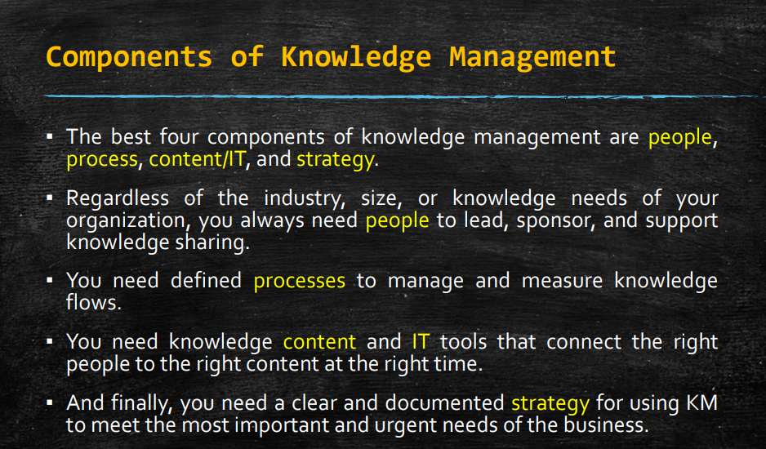

Slide 55
Knowledge based expert system
A Knowledge-Based Expert System (KBES) is a computer program that uses artificial intelligence techniques to simulate the decision-making ability of a human expert.
These systems rely on a specialized knowledge base and inference rules to solve complex problems, provide recommendations, or perform tasks that typically require human expertise.
Components of a Knowledge-Based Expert System
Knowledge Base:
Description: Contains the domain-specific knowledge needed to solve problems, including facts, rules, and heuristics.
Example: In a medical diagnosis expert system, the knowledge base would include information about diseases, symptoms, diagnostic procedures, and treatment protocols.
2. Inference Engine:
Description: The core component that applies logical rules to the knowledge base to deduce new information or make decisions.
Example: The inference engine in a medical diagnosis system would match patient symptoms to known disease patterns to suggest possible diagnoses.

Slide 56
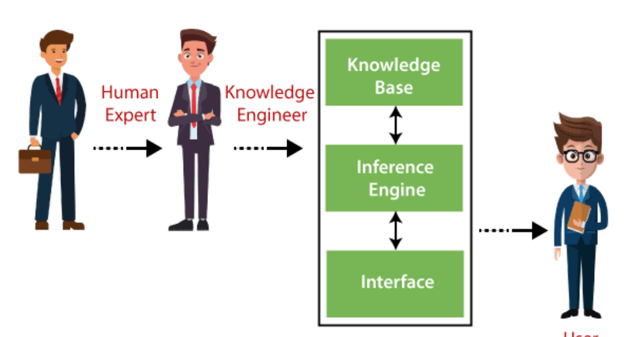

Slide 57
Knowledge based expert system
User Interface:
Description: Allows users to interact with the expert system, input data, and receive advice or solutions.
Example: A graphical interface where doctors can enter patient symptoms and view the system’s diagnostic suggestions.
Knowledge Acquisition Component:
Description: Facilitates the addition of new knowledge to the system, often through tools that allow experts to input their knowledge directly.
Example: An interface that allows medical experts to update the system with new research findings or clinical guidelines.
Explanation Facility:
Description: Provides explanations of the reasoning process and decisions made by the expert system, enhancing transparency and trust.
Example: When the system suggests a diagnosis, it also provides an explanation detailing how it reached that conclusion based on the symptoms and rules applied.

Slide 58
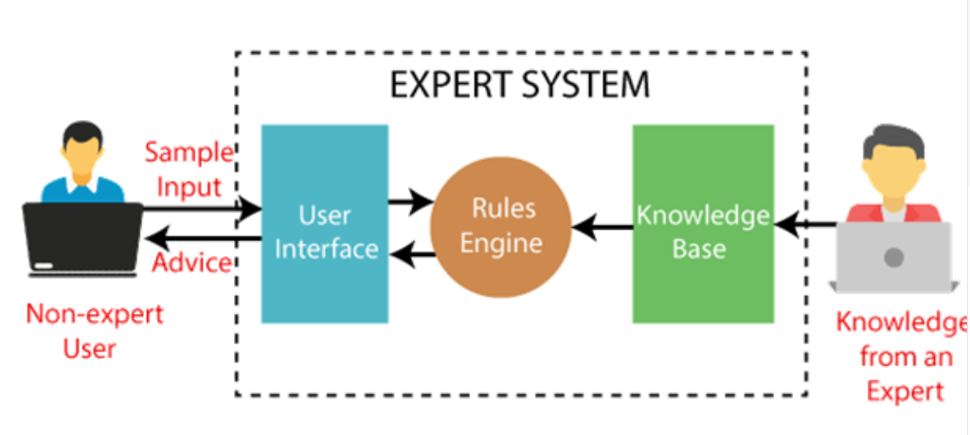
Expert System

Slide 59
User Interface
With the help of a user interface, the expert system interacts with the user, takes queries as an input in a readable format, and passes it to the inference engine. After getting the response from the inference engine, it displays the output to the user. In other words, it is an interface that helps a non-expert user to communicate with the expert system to find a solution
Inference Engine(Rules of Engine)
The inference engine is known as the brain of the expert system as it is the main processing unit of the system. It applies inference rules to the knowledge base to derive a conclusion or deduce new information. It helps in deriving an error-free solution of queries asked by the user.
With the help of an inference engine, the system extracts the knowledge from the knowledge base.
There are two types of inference engine:
Deterministic Inference engine: The conclusions drawn from this type of inference engine are assumed to be true. It is based on facts and rules.
Probabilistic Inference engine: This type of inference engine contains uncertainty in conclusions, and based on the probability.

Slide 60
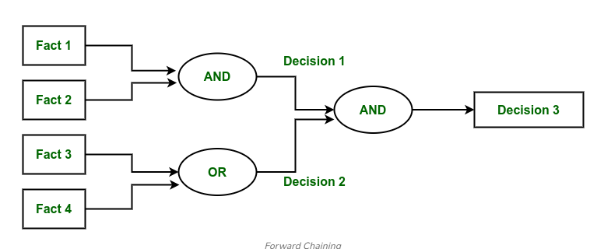
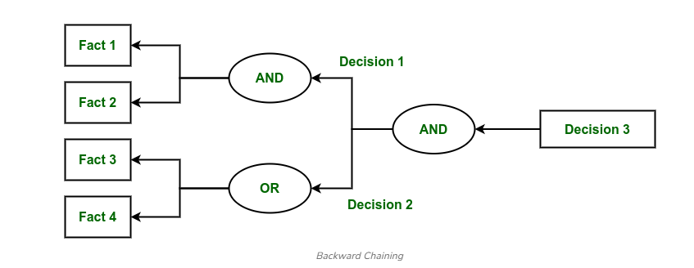
Inference engine uses the below modes to derive the solutions:
Forward Chaining: It starts from the known facts and rules, and applies the inference rules to add their conclusion to the known facts. What will happen next?
Backward Chaining: It is a backward reasoning method that starts from the goal and works backward to prove the known facts. Why this has happened?

Slide 61
Knowledge Base
The knowledgebase is a type of storage that stores knowledge acquired from the different experts of the particular domain. It is considered as big storage of knowledge. The more the knowledge base, the more precise will be the Expert System.
It is similar to a database that contains information and rules of a particular domain or subject.
One can also view the knowledge base as collections of objects and their attributes. Such as a Lion is an object and its attributes are it is a mammal, it is not a domestic animal, etc.
Factual Knowledge: The knowledge which is based on facts and accepted by knowledge engineers comes under factual knowledge.
Heuristic Knowledge: This knowledge is based on practice, the ability to guess, evaluation, and experiences.
Knowledge Representation: It is used to formalize the knowledge stored in the knowledge base using the If-else rules.
Knowledge Acquisitions: It is the process of extracting, organizing, and structuring the domain knowledge, specifying the rules to acquire the knowledge from various experts, and store that knowledge into the knowledge base.

Slide 62
Participants in the development of Expert System
There are three primary participants in the building of Expert System:
Expert: The success of an ES much depends on the knowledge provided by human experts. These experts are those persons who are specialized in that specific domain.
Knowledge Engineer: Knowledge engineer is the person who gathers the knowledge from the domain experts and then codifies that knowledge to the system according to the formalism.
End-User: This is a particular person or a group of people who may not be experts, and working on the expert system needs the solution or advice for his queries, which are complex.

Slide 63
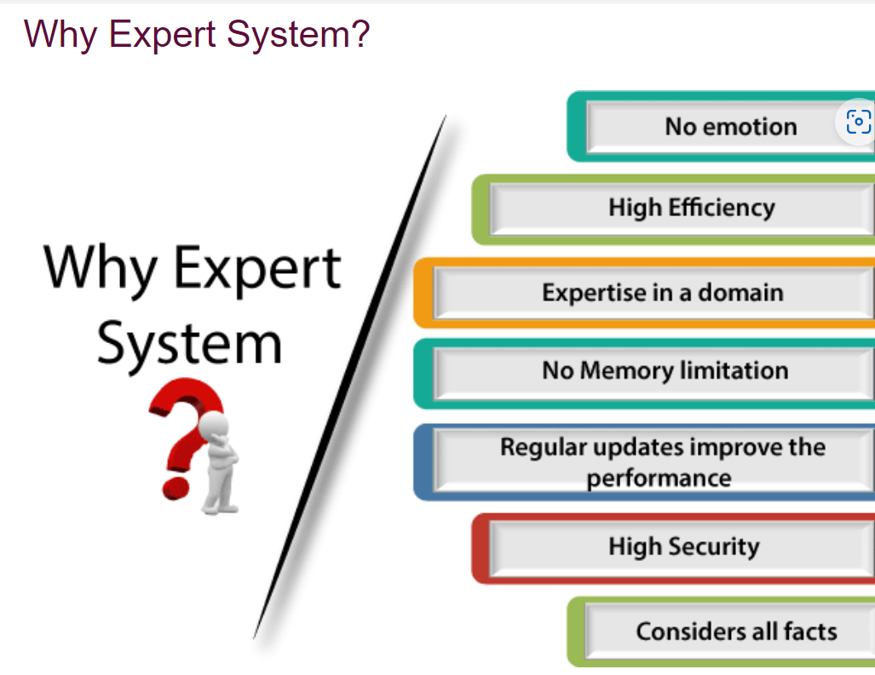

Slide 64
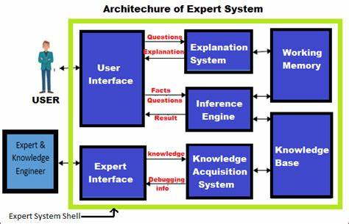
Expert System architecture

Slide 65
Characteristics of an Expert System :
Human experts are perishable, but an expert system is permanent.
It helps to distribute the expertise of a human.
One expert system may contain knowledge from more than one human experts thus making the solutions more efficient.
It decreases the cost of consulting an expert for various domains such as medical diagnosis.
They use a knowledge base and inference engine.
Expert systems can solve complex problems by deducing new facts through existing facts of knowledge, represented mostly as if-then rules rather than through conventional procedural code.
Expert systems were among the first truly successful forms of artificial intelligence (AI) software.

Slide 66
Limitations :
Do not have human-like decision-making power.
Cannot possess human capabilities.
Cannot produce correct result from less amount of knowledge.
Requires excessive training

Slide 67
Adv/disadv – Expert System
Advantages :
Low accessibility cost.
Fast response.
Not affected by emotions, unlike humans.
Low error rate.
Capable of explaining how they reached a solution.
Disadvantages :
The expert system has no emotions.
Common sense is the main issue of the expert system.
It is developed for a specific domain.
It needs to be updated manually. It does not learn itself.
Not capable to explain the logic behind the decisio

